Slide 1
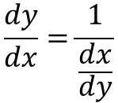




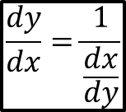

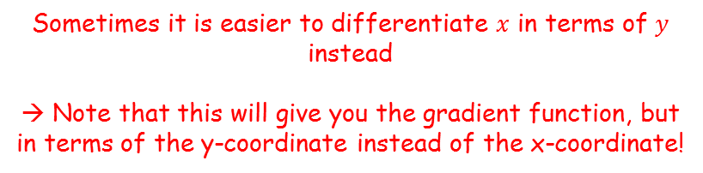


Differentiation
$$\frac{dy}{dx}=\frac{dy}{du}×\frac{du}{dx}$$
If $y={\left(f(x)\right)}^{n}$
Then $\frac{dy}{dx}={n\left(f(x)\right)}^{n−1}f′(x)$
If $y=f(g\left(x\right))$
Then $\frac{dy}{dx}=f^{′}\left(g\left(x\right)\right)g′(x)$
$$\frac{dy}{dx}=\frac{1}{\frac{dx}{dy}}$$
You need to be able to differentiate using the chain rule
There is one final rule that you can use (which you saw in the previous section)
$$\frac{dy}{dx}×\frac{dx}{dy}=1$$
Divide both sides by $\frac{dx}{dy}$
$$\frac{dy}{dx}=\frac{1}{\frac{dx}{dy}}$$
Sometimes it is easier to differentiate $x$ in terms of $y$ instead
→ Note that this will give you the gradient function, but in terms of the y-coordinate instead of the x-coordinate!
9C

Slide 2






Differentiation
$$\frac{dy}{dx}=\frac{dy}{du}×\frac{du}{dx}$$
If $y={\left(f(x)\right)}^{n}$
Then $\frac{dy}{dx}={n\left(f(x)\right)}^{n−1}f′(x)$
If $y=f(g\left(x\right))$
Then $\frac{dy}{dx}=f^{′}\left(g\left(x\right)\right)g′(x)$
$$\frac{dy}{dx}=\frac{1}{\frac{dx}{dy}}$$
You need to be able to differentiate using the chain rule
Find the value of $\frac{dy}{dx}$ at the point $(2,1)$ on the curve with equation $y^{3}+y=x$
$$x=y^{3}+y$$
Differentiate using normal rules
$$\frac{dx}{dy}={3y}^{2}+1$$
‘Invert’ both sides
$$\frac{dy}{dx}=\frac{1}{{3y}^{2}+1 }$$
Sub in the y-coordinate
$$\frac{dy}{dx}=\frac{1}{{3(1)}^{2}+1 }$$
Calculate
$$\frac{dy}{dx}=\frac{1}{4}$$
9C

